Slide 1

MANGALORE INSTITUTE OF TECHNOLOGY & ENGINEERING
(An ISO 9001:2015 Certified Institution)
BADAGA MIJAR, MOODABIDRI – 574225
DEPARTMENT OF COMPUTER SCIENCE & ENGINEERING
(NBA Accredited)
PRESENTATION ON ANALYTICS WITH PYTHON
Under the guidance of
Mrs.Sumalatha U.
Assistant Professor
Department of CS&E
MITE, Moodbidri
Presented by
Pallavi Sharma - 4MT17CS068

Slide 2
CONTENTS
Introduction
Technologies Covered
About Project
Results
Conclusion
References

Slide 3
INTRODUCTION
The Internship was conducted by Heraizen Technologies Pvt. Ltd.
The internship program focused on the following topics.
Python Programming
Working with NoSQL DB and PyMongo
Developing webpages using Angular with Bootstrap
Working with RESTFul Web Services using Flask

Slide 4
TECHNOLOGIES COVERED
Python
MongoDB
Angular
Typescript
Flask
RESTFUL APIs

Slide 5
ABOUT PROJECT
The project is the part of the existing application called DHI.
Problem Statement: Identification of courses (top / bottom n) based on CO attainment scores at the course level, considering common rubrics (C3.2.2 A).
Consists of 3 modules
Faculty
HoD
Principal

Slide 6
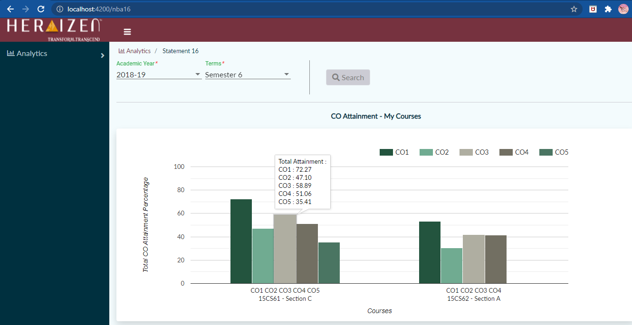
RESULTS
Based on the selection criteria entered by the Faculty, the COs of all the courses that the faculty has taken are displayed on a bar graph.
Fig 1: Bar graph of COs of all the courses.

Slide 7
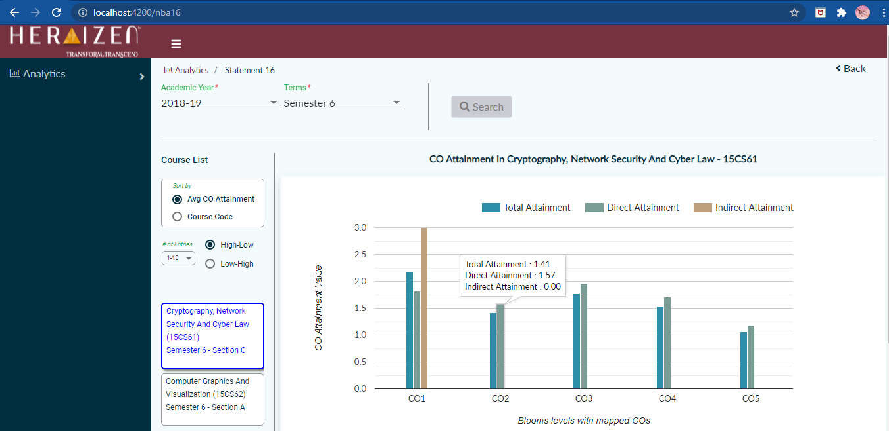
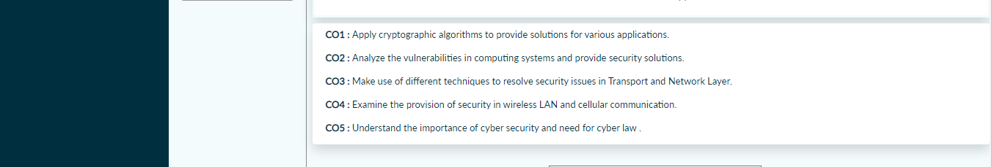
Clicking on any of the CO bars of a course displays a bar graph with additional details of all the COs of the selected course.
Fig 2: Bar graph showing details of all the Cos of selected course.

Slide 8
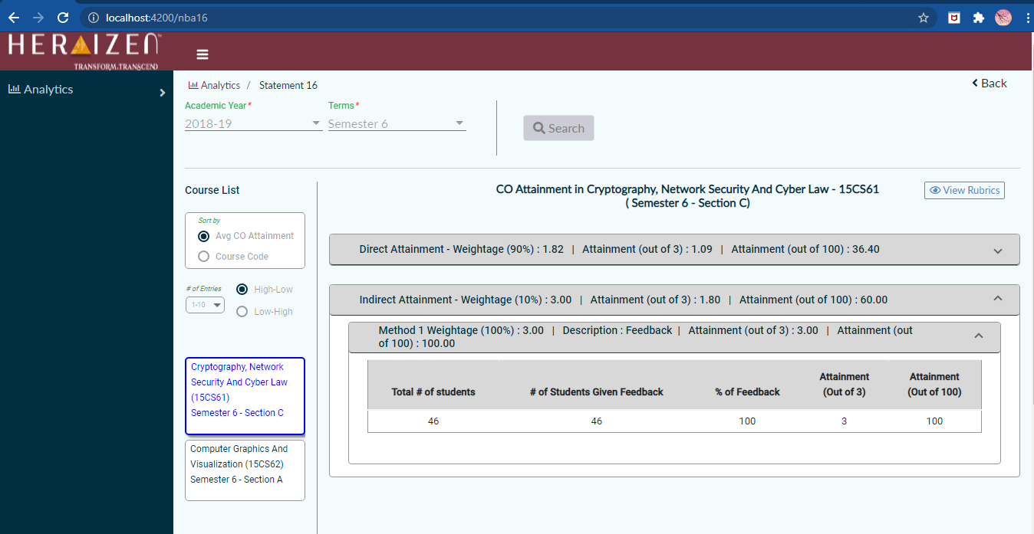
RESULTS
On clicking on any of the clustered bars of a CO of a course, further details of its attainment will be displayed as Accordion table.
Fig 3: Accordion table showing detail of selected CO

Slide 9
CONCLUSION
The Internship was successful in providing a clear view into various concepts and methodologies used while developing Web Applications using Angular Framework as the front end framework.
It also provided a view into the MongoDB database and the NoSQL paradigm.
It also provided knowledge on how the application can be connected to the MongoDB and perform HTTP request and response using flask.

Slide 10
REFERENCES
https://docs.python.org/3/contents.html
https://docs.mongodb.com/
https://angular.io/docs
https://getbootstrap.com/
https://material.angular.io/
https://flask.palletsprojects.com/en/2.0.x/

Slide 11
THANK YOU

